Slide 1

Automated Build and Test
#sqlinthecity
David Atkinson
Product Manager, Red Gate

Slide 2

Goals
#sqlinthecity
Why continuous integration? How to automate the building and testing of your database
Learn about the tools you need
Demo
Do feel free to ask questions!

Slide 3
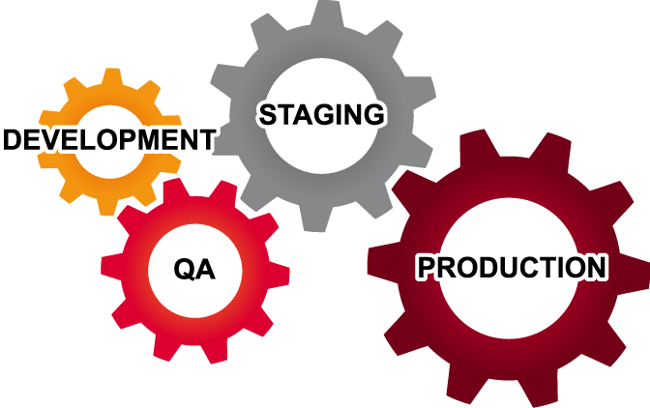
Where does testing happen?
Testing isn’t just done in QA
Be aware of the cost of fixing a bug
Notes:
There are pre-dev phases where testing could also happen –requirements analysis, architecture, functional specification.

Slide 4

Testing in Development
No inter-team interactions
Changes are discrete
Increased frequency of changes

Slide 5
database
^
#sqlcity
What is continuous integration?
“Continuous Integration is a practice designed to ensure that your software is always working, and that you get comprehensive feedback in a few minutes as to whether any given change to your system has broken it.”
“Database Continuous Integration is a practice designed to ensure that your database software is always working, and that you get comprehensive feedback in a few minutes as to whether any given change to your system has broken it.”
Jez Humble, ThoughtWorks, author of “Continuous Delivery”

Slide 6
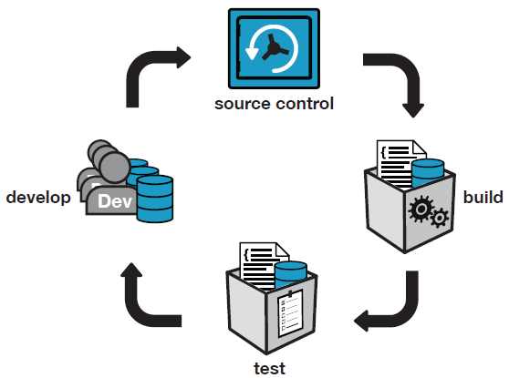
Database Continuous Integration
Notes:
CI server is set up by one person and the whole team of developers benefits.

Slide 7
What is build?
For application code = compile
For database code = database creation script
  But only for a new installation!
Upgrade scripts required for existing installations
  Need to preserve the state of the data
Notes:
The testing of deployment scripts is customarily left to the end.
=> Issues with upgrades only found at the end of a project.

Slide 8
What is test?
For .NET code, NUnit.
  Runs on a developer’s machine and build server
What about the database?
  tSQLt is an open source framework for testing SQL Server databases
  SQL Test provides SSMS integration
Notes:
Although CI catches issues that arise when developers have failed run tests locally, also solving a different problem:
- Two incompatible changes committed by different developers
- “Works on my machine” in development.
Issues that only arise in more realistic integration environments.

Slide 9
Tools we will cover today
#sqlinthecity
TeamCity (CI tool by JetBrains)
SQL Automation Pack (includes the Red Gate TeamCity plugin)
From the SQL Developer Bundle:
SQL Source Control
SQL Test (and tSQLt)
SQL Data Generator
SQL Doc
Notes:
Show of hands for SQL Developer Bundle.
TeamCity is used at Red Gate but *any* build server can be used, eg:
Jenkins, Hudson, TFS Build, CruiseControl, Bamboo, etc.
There is a sqlci.exe command line, and NAnt and MSBuild template wrappers available.

Slide 10
Demo
Create a project in TeamCity
Keep a database up to date on every build
Run tSQLt tests
Generate data
Generate documentation
Generate deployment scripts

Slide 11
Demo

Slide 12
What we’ve done so far
1. Created a…
  Project
    Build Configuration
      Build Step (Red Gate)
2. Specified the VCS root URL:
file:///C:/SVN/SimpleTalk/Database
3. Added a VCS Trigger
Notes:
TeamCity configuration is done!

Slide 13
Keeping a database up to date
With?
Schema
Static data
Why?
A corresponding database for the application
Maintaining a test database with the latest changes

Slide 14
Demo

Slide 15
tSQLt and SQL Test
tSQLt is (the best) free open-source unit testing framework for SQL Server
tSQLt.org
Support via GoogleGroups
Part of the SQL Developer Bundle, SQL Test provides a GUI for tSQLt in SSMS

Slide 16
Why generate test data?
Dev environments are often not realistic
Getting production data not always possible
Random data can result in surprises
Volume testing

Slide 17
Demo

Slide 18
Two bugs found by SQL Data Generator
NULL Dates
  App code assumed [Date] wouldn’t be NULL
  SQL Data Generator didn’t
  Fix was to change [Date] to be NOT NULL
Performance of v_Articles
  Test passed on dev box
  Failed in more “realistic” CI environment

Slide 19
Demo

Slide 20
Generate SQL Documentation
An up-to-date resource
  For Developers
  DBAs
  Business Analysts

Slide 21
Deployments Scripts
Creation scripts
  For new installations
Upgrade Scripts
  For existing installations
  Requires Deployment Manager
Notes:
Creates database packages, used for reliable and repeatable deployments

Slide 22
Demo

Slide 23
Summary
#sqlinthecity
Why and how to put automated database build and test in place
Overview of the tools required
Can be set up in less than an hour!
Notes:
We’ve covered:
How to create a new build in TeamCity from scratch
(including VCS root, build trigger)
How to use Red Gate’s plugin for SQL CI.
Keeping a database up to date
Testing a database with tSQLt
Generating data
Publishing documentation
Building the deployments scripts (creation and upgrade)
Building a database package that can be consumed by Deployment Manager.

Slide 24
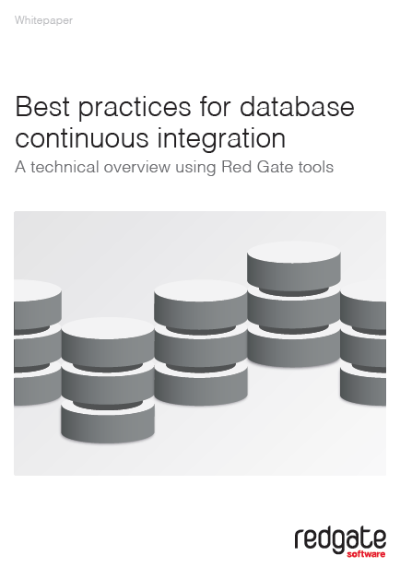
#sqlinthecity
Latest version at :
www.red-gate.com/CI
“Migrations” Focus Group at 14:45 in the Congress Suites
Questions?

